Slide 1
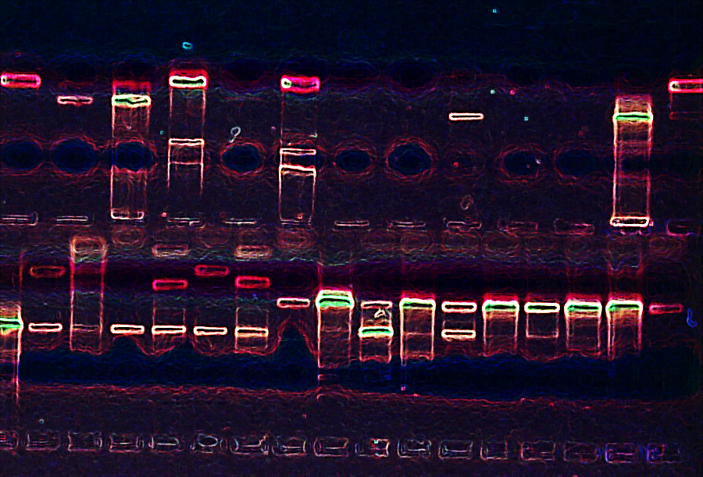
We are group 5 !
Theme: genetics and genomics
Group Members: Arjun, Ricardo, Flynn and Brandon

Slide 2
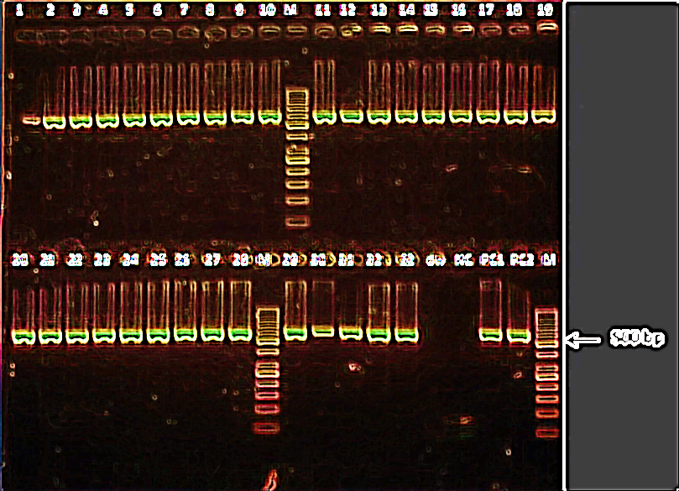
For this project we will be analyzing the data frame “train.csv” sourced from the website, “Kaggle, the data is about contains medical information about children who have genetic disorders.
The data frame has the dimensions train.csv: 22083 x 45 includes information like the hospital the patient was admitted to, the genetic disorder, radiation exposure. Etc.

Slide 3
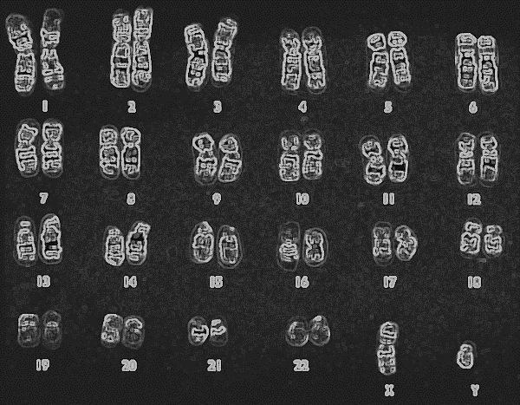
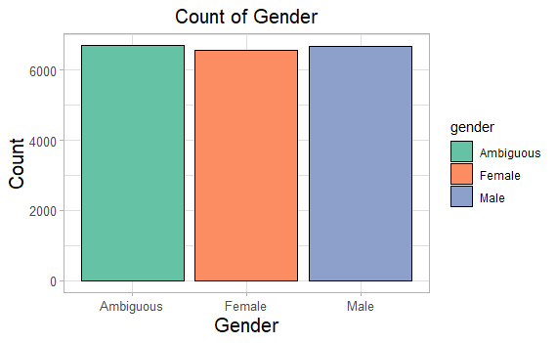
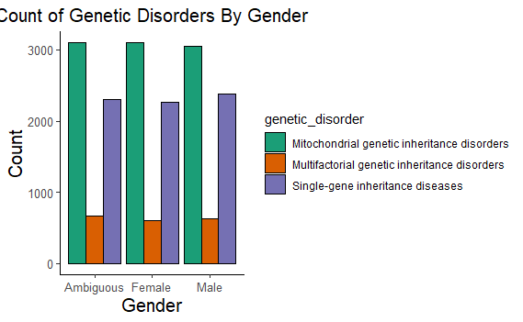
Gender of patients
We find that the data set contains a near equal number of each gender
These three kinds of disorders with its patient’s gender distribution can be seen on the left

Slide 4

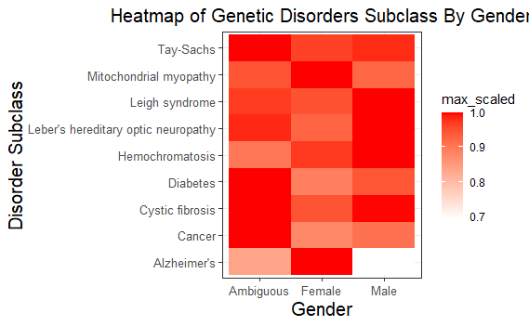
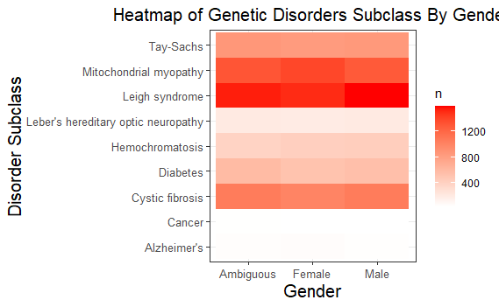
Heatmap of genetic disorders by gender

Slide 5
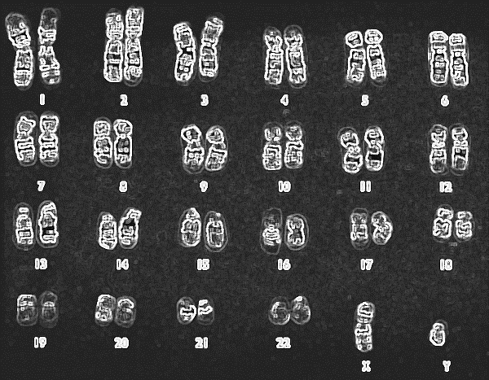

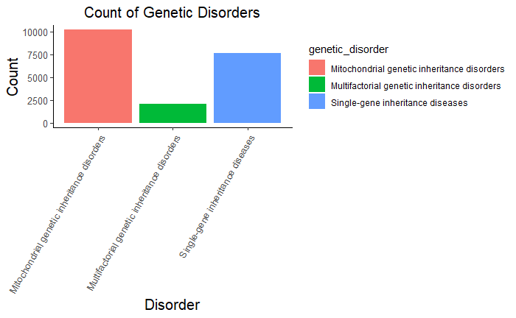
We find three kinds of disorders in the data set, with the following number of patients

Slide 6
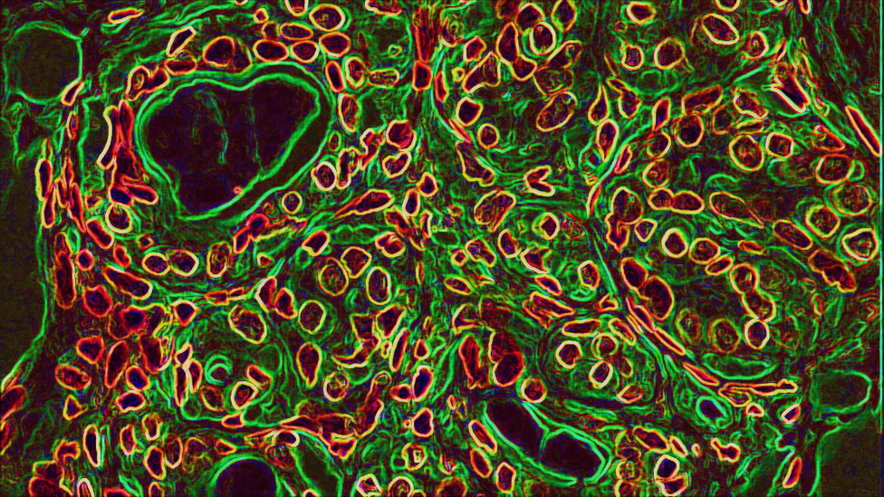

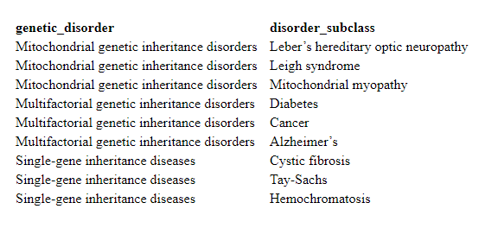
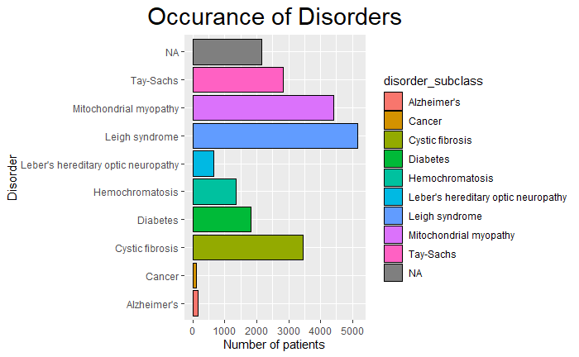
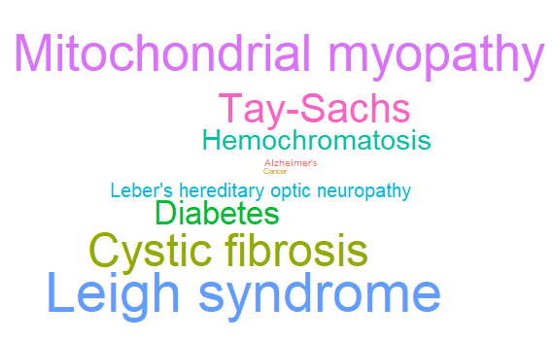

Slide 7
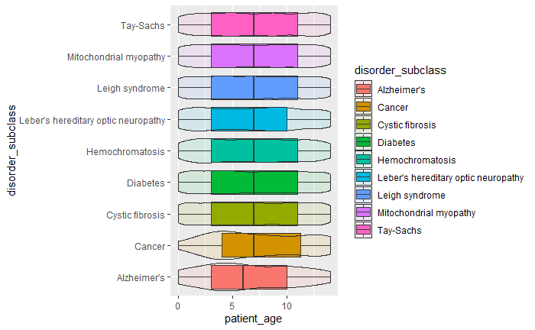
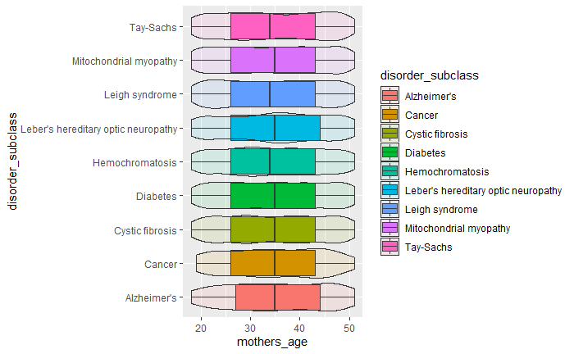
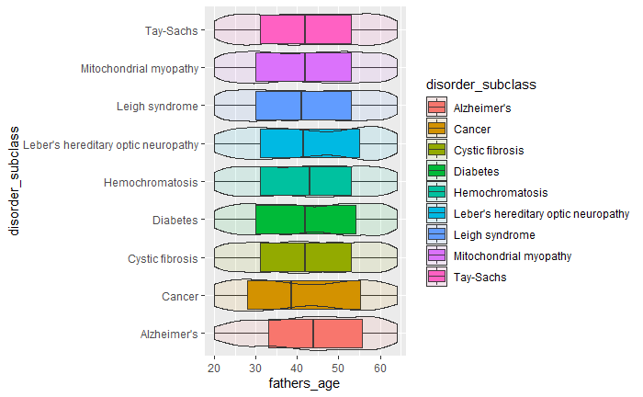
Age of patients, and their parents

Slide 8
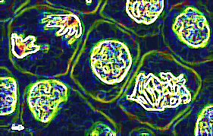
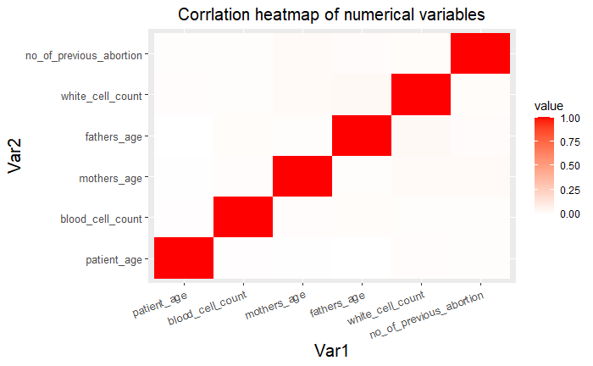
We wanted to find out the correlation between various factors and the disorders

Slide 9

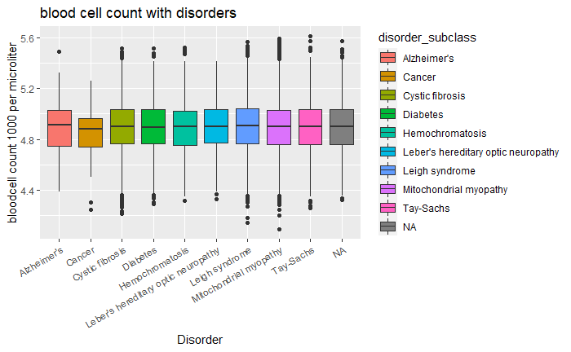
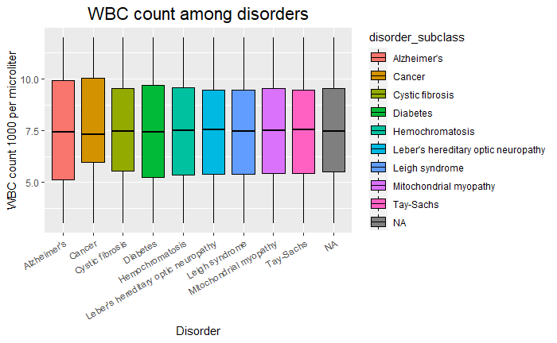
We wanted to find out the whether or not RBC and WBC count in various disorders varied or not. And surprisingly it doesn’t even in the disorder heamochromatosis which does have low RBC count as one of the symptoms

Slide 10
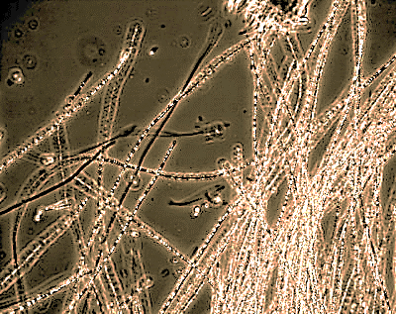
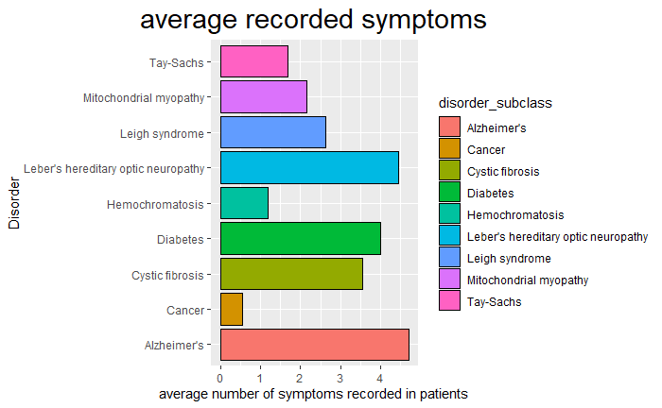
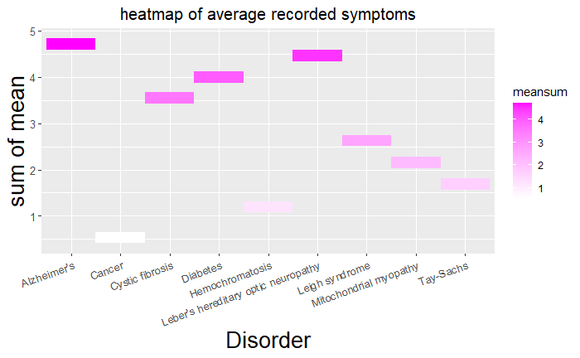
We wanted to find out which disorder is more likely to cause more symptoms. This average can determine which of the disorders is more harmful than others

Slide 11


